Slide 1
Slide Set for Unit/Installation Training Applications*
Cold Weather Injuries: Prevention, Identification, and Treatment
* This slide deck was prepared for adaption and local use by units/installation personnel when conducting cold injury prevention training.
The information presented in these slides and notes sections (as posted) has been approved by the Disease Epidemiology Program (DEP) of the U.S. Army Public Health Center (APHC) as of February 2019. The DEP can be contacted at 410-436-9286 for technical consultation regarding cold injury prevention.
The requirement for Army Cold Weather Injury Prevention training is established by the Army Medical Command – the current (2013) policy memorandum is at https://www.us.army.mil/suite/doc/41860392.
This presentation material includes images from Defense Imagery Management Operations Center, https://www.dimoc.mil/ and slides from U.S. Army Safety Center, https://safety.army.mil/
Additional information links and resources may be obtained from APHC at:
https://phc.amedd.army.mil/topics/discond/cip/Pages/Cold-Weather-Casualties-and-Injuries.aspx
Notes:
There are notes to many of the slides in this slide deck that provide additional details for the presenter.
-----------------------------------------
Last updated by APHC: Feb 2019 (replaces previous version dated Apr 2016)
Slidedeck: Updated footer with slide numbers and classification; slide formatting changes for consistency.
Slide 1: first sentence updated to read “cold injury prevention training” (removed “and illness”); updated organization names from APHC (Prov) to APHC, Injury Prevention Program (IPD) to Disease Epidemiology Program (DEP); updated DEP phone number; updated Defense Imagery, ASC and APHC links.
Slide 39: updated organization name to U.S. Army Public Health Center, and link for Cold Weather Injury Prevention webpage
Slide 40: new slide with additional training resource
-----------------------------------------
Last updated by PHC: April 2016 (replaces previous version dated March 2014)
Slide 1- changed date to April 2016; updated organization name from USAPHC to APHC (Prov)
Slide 26 – Dehydration, changed first bullet to “A condition caused by the excessive loss of water from the body”, changed second bullet to “May increase the risk of hypothermia due to impaired ability to keep active and generate body heat”
Slide 27 deleted “unconsciousness”
Slide 28 deleted “avoid caffeinated liquids (sodas, coffee, tea)”, delete “Avoid coffee, sodas, cocoa, tea and other caffeinated beverages b/c they act as a diuretic, removing fluids from the body” from the notes section
Slide 29 deleted “(non-caffeine)”

Slide 2
Cold Weather Injuries: Prevention, Identification, and Treatment
Presenter’s Name
Presenter’s Command
Local Contact Information
insert date

Slide 3
Introduction
Prevention of cold injuries is a Command and Individual Responsibility
ALL COLD WEATHER INJURIES
ARE PREVENTABLE!!!

Slide 4
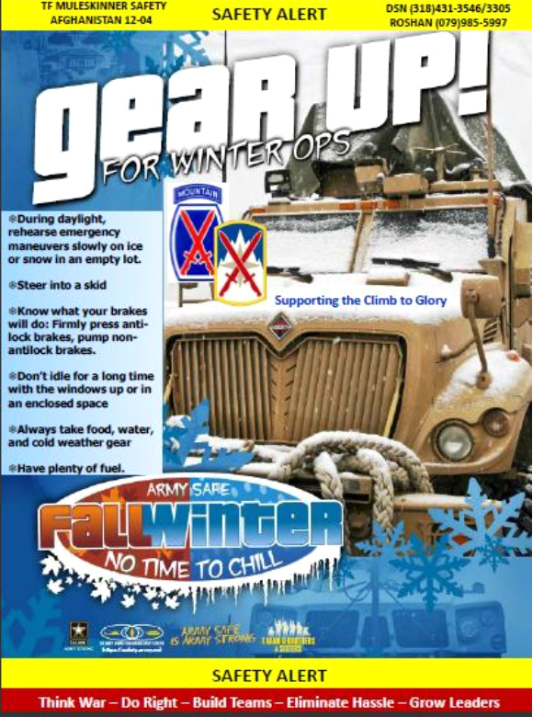
Outline
Susceptibility Factors
Cold Weather Injuries
Description
Identification
Treatment
Prevention
Conclusion

Slide 5
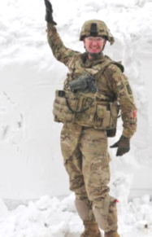
Typical Victim of a Cold Weather Injury
Male
E-4 or below
Around 20 years old
From a warm climate
Less than 18 months time in service
Uses tobacco, alcohol, and/or medications
Neglects proper foot care
However, ANYONE can become a cold weather casualty!
Notes:
The typical cold weather injury casualty is a male approximately 20 years old at the rank of E-4 or below. He is usually from a warm climate and is not acclimated to cold weather and not prepared to survive in those conditions. Soldiers who use alcohol, tobacco or medication could have impaired judgment and miss early warning signs of cold injuries.

Slide 6
Susceptibility Factors
Previous cold weather injury
Inadequate nutrition
Alcohol or nicotine use
Dehydration
Over-activity
Under-activity
Long exposure to the cold
Sick or injured
Ethnic/geographic origin
Wind, cold, rain
Age
Discipline and morale
Physical stamina
Inadequate training
Poor clothing and equipment
Notes:
Anyone from a general to a private can get a cold weather injury if the conditions are right. However, some soldiers are more susceptible than others. Soldiers who have had a cold injury in the past are much more likely to develop a cold injury sooner, or a more severe cold injury in the future.
Previous cold weather injury- those who have had a CWI in the past are more susceptible than others
Inadequate nutrition- underfeeding can cause low blood sugar which can impair shivering and also makes it more difficult to stay active and generate body heat
Alcohol- imparts a sense of warmth, causes dilation of skin blood vessels, increasing heat loss to the environment. Also impairs senses and judgment, making it difficult to detect signs and symptoms of a CWI
Nicotine- causes increased constriction of skin blood vessels, increasing chances of frostbite
Dehydration- can decrease ability to sustain heat-generating physical activity
Over-activity- if over-dressed for the conditions, sweating will lead to wet clothes and increased heat loss when activity has ended
Under-activity- lower heat production

Slide 7
Body Temperature Regulation
Heat Production
Metabolism
Exercise
Shivering
Heat Loss
Convection
Conduction
Radiation
Evaporation
Respiration
When heat loss and production are in balance, body temperature is stable
When heat loss is greater, either in an area of the body (finger, toes) or in the body core, cooling occurs
When cooling is too great, cold weather injury can occur

Slide 8
Types of Cold Injuries
Hypothermia
Frostbite
Non-freezing cold injuries
Chilblains
Immersion/Trench Foot
Injuries related to cold exposure
Dehydration
Sunburn
Snow Blindness
Carbon Monoxide Poisoning

Slide 9
Hypothermia
MEDICAL EMERGENCY; life threatening condition
Severe body heat loss-body temp falls below 95ºF
Occurs when:
cold conditions are severe
conditions are windy, clothing is wet, and/or the individual is inactive
extended water exposure or immersion
1 hour or less when water temp is below 45ºF
prolonged exposure in slightly cool water (e.g. 60ºF)
thunderstorms, hail, rain and accompanying winds
Notes:
Hypothermia is a condition of abnormally low core body temperature which occurs when heat loss exceeds the body’s heat production. Hypothermia is usually associated with cold climates, but it can occur even in warm climates during extended exposure in thunderstorms, hail, rain, and accompanying winds, especially when the soldier has wet clothing or soldier is inactive. When exposed, watch your soldiers carefully for signs of hypothermia.
Human cells, tissues, and organs operate efficiently only within narrow temperature limits. If our body temp rises 2 degrees above the normal 98.6ºF, we may become ill. If it rises 7 degrees, we becomes critically ill. If our body temp decreases 2 degrees, we feel cold. A 7 degree decrease puts our life in jeopardy. If it drops as low as 80ºF, death is likely.

Slide 10
The “umbles”- stumbles, mumbles, fumbles, and grumbles
Hypothermia
Initial Symptoms
shivering
dizzy, drowsy
withdrawn behavior
irritability
confusion
slowed, slurred speech
altered vision
stumbling
Severe Stages
stops shivering
desire to lie down and sleep
heartbeat and breathing are faint or undetectable
unconsciousness followed by DEATH
Notes:
Signs and symptoms of hypothermia change as body temperature falls. Mental functions tend to decline first, and the soldier loses his ability to respond appropriately to the environment. Muscular functions deteriorate until he/she is too clumsy to walk or stand. Biochemical processes become slow and deficient as the body cools. Unfortunately, early signs and symptoms of hypothermia can be difficult to recognize and may easily go undetected. A victim may deny he/she is in trouble; believe the symptoms, not the victim.
Mental signs: The soldier’s decision making ability deteriorates. His/her response to cold becomes slow, improper, or indifferent. His/her general state becomes apathetic and lethargic, and s/he expresses increased complaints. His/her cooperation in group activities decreases. S/he may also exhibit slurred speech, accompanied by disorientation progressing to incoherence, irrationality, and possible unconsciousness.
Physical (muscular) signs: In the early and moderate stages of hypothermia, the soldier exhibits shivering. A hypothermic soldier loses fine motor ability, which may progress to stumbling, clumsiness, and falling. In severe cases, shivering ceases, and the soldier exhibits stiffness and inability to move.

Slide 11
Hypothermia
Treatment
prevent further cold exposure
evacuate immediately if severe hypothermia
remove wet clothing
rewarm with body-to-body contact or in a warmed sleeping bag
warm, sweet liquids if conscious
give CPR if needed
Notes:
Preferred method is to immediately and very gently evacuate the casualty.
Moderate hypothermia:
Move the casualty out of the wind to a sheltered environment. Replace wet clothing with dry clothing or sleeping bags. Cover the casualty with blankets or other insulating material. Apply heating pads wrapped in towels to the casualty’s armpits, groin, abdomen. If patient is conscious and alert, give warm, nutritious fluids to drink and simple, sweetened foods to eat, including candy bars. Carbohydrates are the fuel most quickly transformed into heat and energy. Do not give alcoholic beverages or tobacco products. Wrap from head to toe and gently evacuate to a medical facility in a recumbent (lying down) position.
Severe hypothermia:
Cut away wet clothing and replace with dry clothing. Ensure that the casualty’s airway remains open. Perform mouth-to-mouth resuscitation if the casualty’s breathing rate drops below five respirations per minute. Apply an additional heat source. One method is to place the casualty in a sleeping bag with his outer clothing removed and have another soldier remove his outer clothing and get into the sleeping bag also (monitor rescuer for hypothermia). Cover both soldiers with additional clothing. Evacuate the casualty to a medical facility as soon as possible. Handle very gently since hypothermia causes an irritable heart which could result in a cardiac event. During evacuation, the soldier should be insulated from the cold surfaces of a vehicle or sled.

Slide 12
Hypothermia
Prevention
wear uniform properly (layers worn loosely)
stay dry
keep active
eat properly and often
warm liquids and water
warming tents
get plenty of rest
buddy watch/observation/NCO checks
Notes:
Prevention, early detection, and immediate evacuation are the leader initiatives through which hypothermia should be managed in the field. Prevention involves the proper use of clothing and equipment by soldiers and continual interaction by leaders with their troops. Leaders must circulate among their soldiers and be alert for cold injury signs and symptoms. When hypothermia is detected in its early stage, a soldier may respond well to the removal of the cold stress. A rewarmed soldier should not return to the cold until his energy and fluid reserves have been replenished.

Slide 13
Hypothermia Symptoms
BODY TEMP | SYMPTOMS | OBSERVABLE IN OTHERS | FELT BY YOURSELF
(Early Stage) 98.6 ⇒ 95.0 | Intense and uncontrollable shivering; ability to perform complex tasks impaired. | Slowing of pace. Intense shivering. Poor coordination. | Fatigue. Uncontrollable fits of shivering. Immobile, fumbling hands.
(Moderate Stage) 95.0 ⇒ 91.4 | Violent shivering persists, difficulty in speaking, sluggish thinking, amnesia begins to appear. | Stumbling, lunching gait. Thickness of speech. Poor judgment. | Stumbling. Poor articulation. Feeling of deep cold or numbness.
(Severe Stages) 91.4 ⇒ 87.8 | Shivering decreases; replaced by muscular rigidity and erratic, jerky movements; thinking not clear but maintains posture. | Irrationality, incoherence. Memory lapses, amnesia. Hallucinations. Loss of contact with environment. | Disorientation. Decrease in shivering. Stiffening of muscles. Exhaustion, inability to get up after a rest.
87.8 ⇒ 85.2 | Victim becomes irrational, loses contact with environment, drifts into stupor; muscular rigidity continues; pulse and respiration slowed. | Blueness of skin. Decreased heart and respiratory rate. Dilation of pupils. Weak or irregular pulse. Stupor. | Blueness of skin. Slow, irregular, or weak pulse. Drowsiness.
85.2 ⇒ 78.8 | Unconsciousness; does not respond to spoken words; most reflexes cease to function; heartbeat becomes erratic. | Unconsciousness.
78.8 ⇓ | Failure of cardiac and respiratory control centers in brain; cardiac fibrillation; probable edema and hemorrhage in lungs; apparent death.

Slide 14
Frostbite
Air temps below 32ºF
skin freezes at 28ºF
Superficial frostbite (mild)
freezing of skin surface
Deep frostbite (severe)
freezing of skin and flesh, may include bone
Hands, fingers, feet, toes, ears, chin, nose, groin area
Notes:
Skin freezes at about 28 degrees Fahrenheit. Frostbite is freezing or crystallization of living tissues. Exposure time can be minutes or instantaneous if skin is directly exposed to extreme cold or high winds. The extremities (fingers, toes, ears, penis) and face are affected first. Extent of frostbite depends on temperature and duration of exposure.
As superficial frostbite develops, skin will become numb and turn to a gray or waxy-white color. The area will be cold to the touch and may feel stiff or woody, but the underlying tissue will be soft.
Deep frostbite extends beyond the first layer of skin and may include the bone. Joint movement may be absent or restricted depending on the extent of the injury. Discoloration is the same as for superficial frostbite, but the underlying tissue is hard. If an entire area is frostbitten, such as an entire foot or hand, tissues may appear purple as the result of sludging of blood within the vessels. A blackened appearance will be noticed after the injury has thawed.

Slide 15
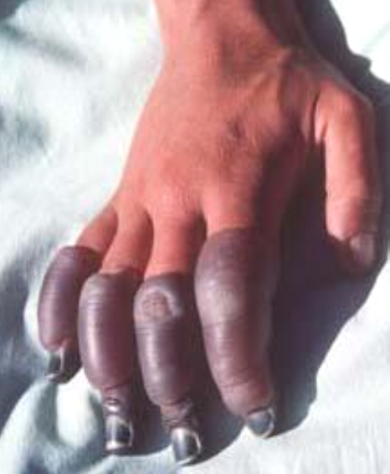
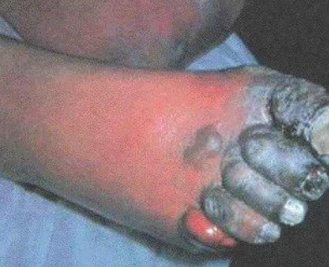
Frostbite
Symptoms
initially redness in light skin or grayish in dark skin
tingling, stinging sensation
turns numb, yellowish, waxy or gray color
feels cold, stiff, woody
blisters may develop
Notes:
Symptoms of frostbite vary and may include a cold feeling, pain, burning, followed by numbness as it progresses in severity. The skin turns pale or grayish, appearing frosty or waxy white. The skin may feel hard, may not be movable over the joints and bony prominence, or may be frozen. The level of deep frostbite cannot be determined in the field. It may take 3 to 7 days or longer for medical personnel to ascertain the extent of the injury. Blisters, swelling, and pain may occur after thawing.
As superficial frostbite develops, skin will become numb and turn to a gray or waxy-white color. The area will be cold to the touch and may feel stiff or woody, but the underlying tissue will be soft.
Deep frostbite extends beyond the first layer of skin and may include the bone. Joint movement may be absent or restricted depending on the extent of the injury. Discoloration is the same as for superficial frostbite, but the underlying tissue is hard. If an entire area is frostbitten, such as an entire foot or hand, tissues may appear purple as the result of sludging of blood within the vessels. A blackened appearance will be noticed after the injury has thawed. This category of frostbite requires immediate evacuation to a medical facility.

Slide 16
Frostbite
Treatment
remove from cold and prevent further heat loss
remove constricting clothing and jewelry
rewarm affected area evenly with body heat until pain returns
when skin thaws it hurts!!
do not rewarm a frostbite injury if it could refreeze during evacuation or if victim must walk for medical treatment
do not massage affected parts or rub with snow
evacuate for medical treatment
Notes:
For early signs of superficial frostbite:
You must take action at once if you notice your feet, hands or parts of your face becoming numb. If your feet are numb, place your bare feet against the warm belly of a buddy and keep them there until the pain returns. There should be very little pressure placed on the affected areas to ensure that the ice crystals do not further damage the tissue. If your face is numb, cover the area with your bare hands until the pain returns. DO NOT massage the affected area as this will cause further damage-the crystallized tissues may break internally and cause more damage. If your hands are numb, place them under your clothes, in your armpits or on your belly. DO NOT apply ointments or medications to the frostbitten area. DO NOT give alcoholic beverages or tobacco products. Give the casualty something warm to drink. Remember, when the skin starts to thaw, it will hurt. Do not lance blisters; cover them with sterile dressing.
If tissues freeze, evacuate the victim immediately as a litter casualty. Thawing of a frostbitten victim is a medical procedure and should not be done by nonmedical personnel.
If you must continue to walk on frostbitten feet, do not thaw the affected area until walking is no longer necessary. It will be nearly impossible to walk on thawed, frostbitten feet and it will be extremely painful. Walking on frozen feet does less harm than walking on thawed feet.
Motrin

Slide 17
Frostbite
Prevention
wear uniform properly (layers and loosely)
keep socks and clothing dry (use poly pro/thermax liner socks and foot powder/ change insoles also)
protect yourself from wind
drink hot fluids and eat often
keep active
insulate yourself from the ground (sleeping pad/tree branches, etc.)
“Buddy System”
warm with body heat
avoid skin contact with super-cooled metals or fuel
seek medical aid for all suspected cases
Notes:
To prevent frostbite, wear your uniform properly (avoid tight fitting clothing, wear mittens instead of gloves, change socks often). Keep your socks and clothing dry and protect yourself from the chilling effects of the wind. Keep major muscle groups moving. If unable to walk or exercise, keep hands and feet warm by moving fingers and toes. Fingers may be warmed quickly by swinging arms in a wide arch from an extended side position to a front position and hitting hands together until warmth is restored. Move lips from side to side and up and down to increase blood circulation throughout the face to help prevent cold injury to facial tissue. Use caution around fuels and metals. Insulate yourself from the ground. Drink plenty of hot fluids, eat often, and get plenty of rest.
Contributing factors to frostbite:
Dehydration
Below freezing temps and wind chill
Skin contact with super-cooled metals or liquids
Use of caffeine, tobacco, or alcohol
Constriction of an extremity, which may be caused by tight boots, gloves, gaiters, watchbands, or confinement in a cramped position, may reduce blood flow and increase the likelihood of frostbite.
Neglect
Moisture
Cold Stress

Slide 18
Chilblains
Nonfreezing cold injury
Cold, wet conditions (between 32-60ºF, high humidity)
Repeated, prolonged exposure of bare skin
Can develop in only a few hours
Ears, nose, cheeks, fingers, and toes
Notes:
Chilblains is a condition that usually occurs in temperatures above freezing, accompanied by high humidity. It appears as red, swollen skin which is tender, hot to the touch and may itch. This can worsen to an aching, prickly (pins and needles) sensation and then numbness. It can develop in only a few hours in skin exposed to cold. In severe cases, blistering may appear. The most commonly affected areas are the ears, nose, fingers, and toes.

Slide 19
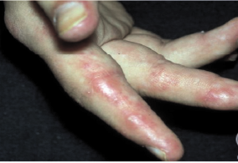
Chilblains
Symptoms:
initially pale and colorless
worsens to achy, prickly sensation then numbness
red, swollen, hot, itchy, tender skin upon rewarming
blistering in severe cases
Notes:
Appears as red, swollen skin which is tender, hot to the touch and may itch. This can worsen to aching, prickly (pins and needles) sensation and then numbness. In severe cases, open sores or bleeding lesions may result from continued exposure.

Slide 20
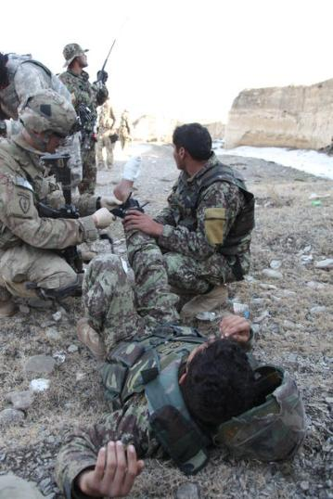
Chilblains
Treatment
prevent further exposure
wash, dry gently
rewarm (apply body heat)
don’t massage or rub
dry sterile dressing
seek medical aid
Notes:
Apply local warming (putting bare hands over the affected area on the face; putting affected hands inside the uniform under the armpits; putting bare feet against the abdomen of another soldier).
Rubbing or massaging the affected area may cause tissue damage. Signs and symptoms of tissue damage may be slow to appear. Have medical personnel evaluate the area for tissue damage.

Slide 21
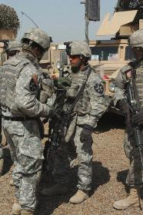
Chilblains
Prevention
keep dry and warm
cover exposed skin
wear uniform properly
use the “Buddy System”
Notes:
Keep exposed areas covered with adequate clothing and try to keep them dry. Rewarm affected parts and protect blisters with a sterile dressing.
Seek medical aid if necessary.

Slide 22
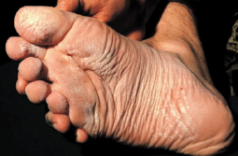
Trench/Immersion Foot
Potentially crippling, nonfreezing injury (temps from 32ºF-50ºF)
Prolonged exposure of skin to moisture (12 or more hours, days)
High risk during wet weather, in wet areas, or when sweat accumulates in boots or gloves
Notes:
Trench foot/Immersion foot results from prolonged exposure to water at temperatures usually below 50 degrees Fahrenheit. It is not limited to the feet and produces severe injury to affected areas. The combination of cold and moisture softens skin, causing tissue loss, and, often, infection. Affected areas become cold, swollen, discolored, waxy, and numb. Blisters may develop. Commonly, immersion syndrome shows a distinct “water line” coinciding with the water level in the boot or glove. Red or bluish blotches appear on the skin, sometimes with open weeping or bleeding. The risk of this potentially crippling injury is high during wet weather or when troops are deployed in wet areas.
Cold/wet conditions constrict blood vessels. Reduced blood flow to the extremity deprives cells of needed oxygen and nutrients. Permanent muscle and nerve damage may result if this cold injury is allowed to develop.
Contributing Factors:
immersing feet in cold water
not changing socks frequently
standing in wet defensive positions
poor hygiene

Slide 23
Trench/Immersion Foot
Symptoms
initially appears wet, soggy, white, shriveled
sensations of pins and needles, tingling, numbness, and then pain
skin discoloration-red, bluish, or black
becomes cold, swollen, and waxy in appearance
may develop blisters, open weeping, or bleeding
in extreme cases, flesh dies
Notes:
Extremity appears cold, swollen, mottled. Cyanosis, a blueness of the skin resulting from imperfectly oxygenated blood, is usually present.
Usually occurs in 3 stages:
1st stage: affected part is cold, without pain. Weak pulse at the site.
2nd stage: affected limb feels hot, as though burning, has shooting pains.
3rd stage: injured Soldier has pale skin, cyanosis around the nailbeds and lips, decreased pulse strength.
When the extremity rewarms, the skin becomes warm, dry, and red. The pulse rebounds and the injury is painful. The injured area may itch, tingle, and exhibit increased sensitivity to cold, possibly permanently. Recovery can take weeks. Nerve damage may be permanent. Development of blisters, ulcers, and gangrene is possible. Amputation may be necessary.

Slide 24
Trench/Immersion Foot
Treatment
prevent further exposure
dry carefully
DO NOT break blisters, apply lotions, massage, expose to heat, or allow to walk on injury
rewarm with body heat
clean and wrap loosely
elevate feet to reduce swelling
evacuate for medical treatment
Notes:
Remove wet clothing and replace with dry, warm clothing.
Warm slowly at room temperature. The affected area will probably become swollen, red, hot to the touch after it has been rewarmed. Blisters may form.
Avoid walking on injured feet
Elevate feet to reduce swelling (edema)
Seek prompt medical attention. Above all, do not break the blisters as this can lead to an infection of the area.
Bed rest and avoidance of trauma until the injury heals. May take an extended period to heal.

Slide 25
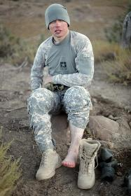
Trench/Immersion Foot
Prevention
keep feet dry
change socks and apply foot powder at least every 8 hours or whenever wet
bring extra boots to field
no blousing bands
report all suspected cases to leadership
Notes:
For the soldier, regular attention to his/her feet, drying them and changing to clean dry socks once a day, or more often if his feet get wet, is all that is needed to prevent immersion foot or trench foot.

Slide 26
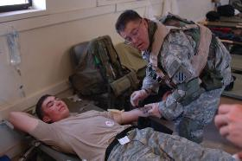
Dehydration
A condition caused by the excessive loss of water from the body
May increase the risk of hypothermia due to impaired ability to keep active and generate body heat
Notes:
Dehydration is a deficiency in body fluids that inhibits body functions. It adversely affects the body’s resistance to cold injury. It can cause serious physical problems and make the soldier more susceptible to other problems, such as frostbite and hypothermia. Proper hydration is essential to supplying fuel and energy to body parts to facilitate heat production.
It is very easy to become dehydrated in cold weather. Soldiers fail to drink enough liquid and underestimate fluid loss from sweating. Thirst is a poor indicator of water requirements. Dehydration is a lack of water in the body. It increases your chances of becoming a cold weather injury casualty and is therefore included in this briefing. Almost all soldiers who become hypothermic are already dehydrated. Dehydration contributes to poor soldier performance in physical activities, even more so than lack of food. Cold weather requirements for water are no different than in the desert and may, in fact, exceed desert requirements b/c of the increased energy expended in operating with additional layers of clothing and trudging through the snow.

Slide 27
Dehydration
Symptoms
dark urine
headache
dizziness, nausea
weakness
dry mouth, tongue, throat, lips
lack of appetite
stomach cramps or vomiting
irritability
decreased amount of urine being produced
mental sluggishness
increased or rapid heartbeat
lethargy
Notes:
Signs: irritability, darkening urine, decreased amounts of urine being produced, dry mouth, tiredness, mental sluggishness, lack of appetite, increased or rapid heartbeat, dizziness, and even unconsciousness.

Slide 28
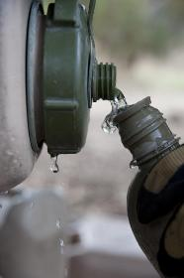
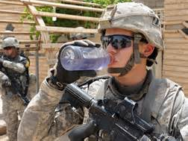
Dehydration
Treatment
drink WATER or other warm liquids
do not eat snow
rest
Notes:
To treat dehydration, give the individual warm liquids to drink. Warm liquids will be consumed more readily in a cold environment than cold beverages. Do not let the victim eat snow as this uses up body heat and might be contaminated by disease causing pathogens.
If the soldier is conscious, administer fluids by mouth. If improvement is not obvious in an hour, evacuate the patient to a medical facility. In advanced stages of dehydration, as in the case of an unconscious soldier, immediately evacuate the patient to a medical facility.

Slide 29
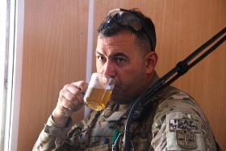
Dehydration
Prevention
drink minimum of 3 canteens of water daily if inactive and 5-6 quarts if active
monitor urine color
do not wait until you are thirsty
drink hot liquids for warmth
Notes:
To prevent cold weather dehydration, soldiers should drink a minimum of 3 canteens of water daily. The thirst mechanism does not function properly in cold weather. Soldiers tend to not feel as thirsty as they do when operating in warmer climates. They should monitor their urine. Clear yellow urine means you are okay. Dark yellow urine means you need to drink more. Drink enough water to keep your urine clear. Snow is an emergency source of water. It must first be melted and purified with iodine tablets, calcium hypochlorite or boiling before being consumed.

Slide 30
Sunburn
Burning of the skin due to overexposure to the sun and UV light
Contributing factors
fair skin, light hair
exposed skin
reflective qualities of the snow
high altitudes
Symptoms
redness of skin, slight swelling (1st degree)
prolonged exposure (2nd degree)
pain and blistering
chills, fever, headache
Notes:
Sunburn can be a debilitating cold injury. Because the air temperature seems relatively cold, soldiers may miscalculate the intensity of the sun or simply be too weary to take preventive action. 1st degree burns involve reddening of the skin; 2nd degree burns are characterized by the formation of blisters.
Thinner air allows more of the burning rays of the sun to penetrate the atmosphere and reflect light off of the snow.

Slide 31
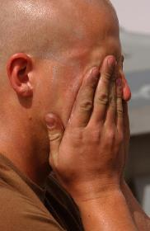
Sunburn
Treatment
soothing skin creams in mild cases
in severe cases, seek medical attention
aspirin for pain
Prevention
cover exposed skin with clothing
sunscreen, lip balm
limit exposure of skin to the environment
Notes:
Sunburn is usually treated on first notice by further application of sunscreens/blocks. In mild cases, sunburned soldiers can continue their duties even though they may suffer significant discomfort for a few days. In more severe cases, such as second degree sunburn, soldiers should be treated by medical personnel who can assess the impact of their injuries on their assigned duties. If there is much swelling, cold compresses should be applied. Aspirin may be taken for pain, and warm liquids should be administered to replenish body fluids.
Clothing provides adequate coverage of the skin; however, exposed areas such as the face, lips, neck, ears, and bare hands are susceptible to sunburn. In addition, light reflection from snow can cause burns in areas not ordinarily affected, such as under the chin, around the eyes, inside the nostrils and ears, and even on the roof of the mouth.

Slide 32
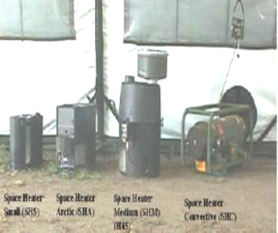
Carbon Monoxide Poisoning
When oxygen in the body is replaced by carbon monoxide
colorless, odorless, tasteless gas resulting from incomplete combustion
Inadequate ventilation from engines, stoves, heaters
Notes:
Carbon monoxide is a colorless, odorless, tasteless gas that results from combustion without enough oxygen. Large amounts of this gas can build up and kill you when there is not proper ventilation for engines, stoves, and heaters. Many soldiers have gone to sleep with motors running and have died from carbon monoxide poisoning.

Slide 33
Carbon Monoxide Poisoning
Symptoms
headache
dizziness
weakness
excessive yawning
ringing in ears
confusion
nausea
bright red lips, eyelids
drowsiness
unconsciousness
possibly death
Notes:
Signs/symptoms progress slowly. At the onset, they may go unnoticed because carbon monoxide is colorless, tasteless, and odorless.
Headache, tiredness, excessive yawning, confusion, followed by unconsciousness, and eventually death. A cherry-red coloring to the tissues of the lips, mouth, and inside the eyelids occurs very late in CO poisoning--when the patient is very near death.

Slide 34
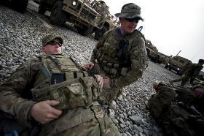
Carbon Monoxide Poisoning
Treatment
move to fresh air immediately
seek medical aid promptly
provide mouth-to-mouth resuscitation if victim is not breathing
Notes:
If you experience any of the symptoms of carbon monoxide poisoning, stay calm and move to fresh air immediately. Panic and haste may cause you to pass out in the area of high carbon monoxide concentration. If a soldier is found unconscious in a running vehicle or a heated tent, immediately take him/her to fresh air and perform mouth to mouth resuscitation until s/he is revived. Send someone for medical aid; severe complications can develop, even in casualties who appear to have recovered perfectly.

Slide 35
Carbon Monoxide Poisoning
Prevention
ensure proper ventilation
don’t use unvented heaters or engines
ensure heaters are regularly serviced
turn heaters off when not needed (during sleep)
never sleep in vehicle with engine running
never wrap poncho around vehicle exhaust to collect heat
Notes:
Prevention is key. Carbon monoxide poisoning can be prevented if unit leaders enforce a few simple rules:
don’t permit soldiers to sleep in vehicles while engines are operating
ensure tent stoves and heaters are regularly serviced and inspected to confirm safe operation
ensure that sleeping tents have proper ventilation
*Tent eye is caused by fumes emanating from stoves and lanterns operated in a poorly ventilated shelter. It can be prevented by using properly functioning stoves and lanterns, and adequately ventilating the shelter. First aid for tent eye is fresh air.

Slide 36
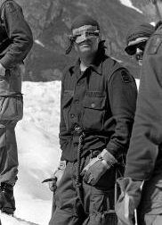
Snow Blindness
Inflammation and sensitivity of the eyes caused by ultraviolet rays of the sun reflected by the snow or ice
Symptoms
gritty feeling in eyes
redness and tearing
eye movement will cause pain
headache
Notes:
Snow blindness is a very painful inflammation of the eyes (cornea) caused by an overexposure to the ultraviolet rays of the sun. The eyes will become bloodshot, feel irritated and “full of sand”. The eyes will be red and there can be a lot of tearing. Moving the eyes will cause pain.

Slide 37
Snow Blindness
Treatment
remove from sunlight
blindfold both eyes or cover with cool, wet bandages
seek medical attention
recovery may take 2-3 days
Prevention
eye protection
dark, UV protective glasses
field expedient-cut narrow slits in MRE cardboard and tie around head
do not wait for discomfort to begin
Notes:
If snow blindness develops, blindfold both eyes and apply a clean, cool wet compress to the eyes. This stops further damage to the eyes and reduces the pain associated with movement. If further exposure is unavoidable, use the darkest glasses or bandages with tiny pinholes to decrease further damage while letting the injured soldier function. Seek medical attention immediately. Aspirin can by used to control the pain. Recovery may take two to three days.

Slide 38
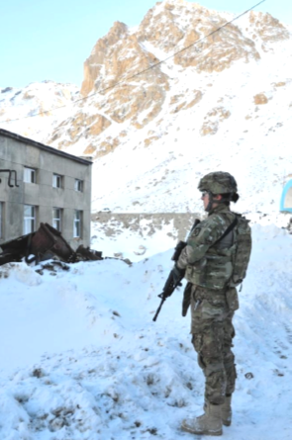
Conclusion
Dress properly
Drink plenty of fluids
Eat right
Keep in shape
Get plenty of rest
Minimize periods of inactivity
Maintain a positive attitude

Slide 39
References and Resources
TB MED 508 Prevention and Management of Cold Weather Injuries
TC 21-3 Soldier’s Handbook for Individual Operations and Survival in Cold-Weather Areas
FM 21-10 Field Hygiene and Sanitation
FM 4-25.11 First Aid
U.S. Army Public Health Center Cold Weather Injury Prevention webpage: https://phc.amedd.army.mil/topics/discond/cip/Pages/Cold-Weather-Casualties-and-Injuries.aspx
U.S. Army Research Institute of Environmental Medicine Guidance downloads: http://www.usariem.army.mil/index.cfm/publications/guidance

Slide 40
References and Resources
Individuals interested in heat illness and CWI on-line training that produces a certificate:
Central Army Registry (CAR) Virtual Mission Preparation Course (Hot/Cold Weather Injury)
Go to: https://rdl.train.army.mil
Log in with CAC
In the “Search the CAR” field in the upper left, paste “553G D01 Virtual Mission Preparation Course (Hot/Cold Weather Injury Prevention)”
Click on the blue hyperlink
EAMS-A may be required, which should lead to a page describing the training
Scroll down and click on the “View” button at the bottom

Slide 41
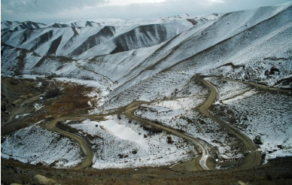
Questions?

